Slide 1
Introduction to Assessment for PGCE students
Presenter name | Job title | Date

Slide 2
What we will cover
Why do we assess?
    History of Assessment
    Current processes
  Key principles of Assessment
    Reliability
    Validity
  How we assess
    Assessment objectives
    Comparability

Slide 3
Part 1
Why do we assess?
Notes:
There are a number of possible reasons:
Rewarding individual student performance
Selecting students for future institutions, courses, occupations etc.
Predicting students' potential performance at university
Measuring school performance
Monitoring national education system
Without assessment we would depend on patronage – see upcoming slide

Slide 4
Different types of assessment
There are two different types of assessment:
    Summative assessment – assesses learning at the end of a course of study – GCSE, A Level, degree etc.
    Formative assessment – ongoing assessment during a course of study in order to focus teaching on improvement
It is summative assessment that we are largely concerned with here.

Slide 5
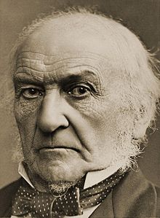
The introduction of Civil Service Exams
Gladstone, Chancellor of the Exchequer 1852-55, argued for “…setting up competition as against restriction or private favour. I am convinced that we have it in our power to render an immense service to the country by a circumspect but energetic endeavor to apply a like principle to the Civil Service and the great administrative departments.”
Notes:
Gladstone, who later became Prime Minister, argued in favour of civil service exams, as an open system in preference to a system of patronage. The first evidence of testing goes back 2000 years. Tests were used for over a thousand years from about 600 CE until 1905 for selection to the civil service in Ancient China.

Slide 6
The development of exams in England
In England, matriculation exams were first used by the universities in the 1830s
In the late 1850s Oxford and Cambridge “Locals” exams were introduced for students still at school
They developed over time into having two purposes
    School leaving certificates
    Entry tests for the universities
  A Levels were introduced in 1951 alongside O Levels
  GCSEs were first introduced in 1988, combining O Levels and CSEs
  Since the 1980s testing has become more important and high profile
  More weight is attached to exam results for both students and schools/colleges
  We have three “high stakes” tests in England – Key Stage 2 SATS, KS4 GCSE and KS5 A Level
Notes:
A Levels replaced the Higher School Certificate and O Levels replaced the School Certificate. These qualifications were aimed at grammar and public school students aiming for university. CSEs were introduced in 1965 for students not sitting O Levels. The involvement of the universities in England led to the involvement of university exam boards – Oxford and Cambridge through what became OCR – and historically other universities including London and Manchester.

Slide 7
History of OCR and Cambridge Assessment
1855 Society of arts trade exams
1857 University of Oxford Delegacy of Local Examinations
1858 University of Cambridge Local Examinations Syndicate
1998 OCR formed (incorporating eleven different boards)
2005 Cambridge Assessment formed
Cambridge Assessment is a department of the University of Cambridge. It includes OCR, Cambridge Assessment International Education and Cambridge Assessment English.
It was announced in October 2020 that Cambridge Assessment is to merge with Cambridge University Press.
Notes:
OCR has a long history in assessment dating back to 1857. The Society of Arts later became the Royal Society of Arts. It later merged with the Oxford and Cambridge boards to become OCR in 1998. OCR is part of Cambridge Assessment, a department of the University of Cambridge.

Slide 8
Criticisms of exams
Student Impact
  Defining ability or pathway
  Statement of ‘ability’
  Affects future job prospects
Effect on the Curriculum
  Teaching to the test
  Depth v Breadth
  Training students for exams
Notes:
Criticisms of exams date back to their introduction. The criticisms haven’t changed much over the years.

Slide 9
Criticisms of exams
Value of what is assessed
  Skills v Knowledge
Lack of teacher control
Inequalities
  Are they fair to all students?
  Are they accessible?
Use of exams for statistics
  Fair use of results
  Performance related decisions

Slide 10
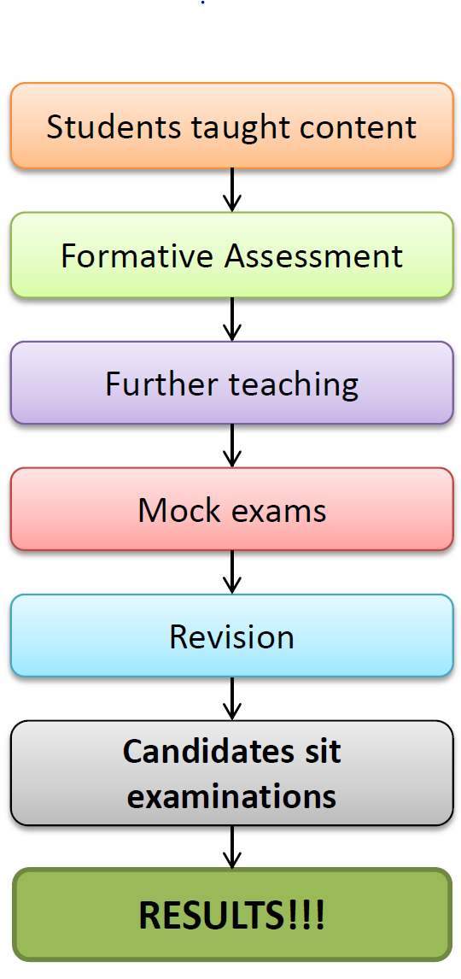
The Examination Process - Schools
Typical model of a student’s journey
Generally a two or three year process

Slide 11

How are exams created and marked?
Creation
https://www.youtube.com/watch?time_continue=2&v=VT4UNs9aSS4
Other Awarding organisations have similar videos if you are not teaching OCR Specifications!
Compare the videos – the principles and processes across all awarding organisations are very similar!

Slide 12
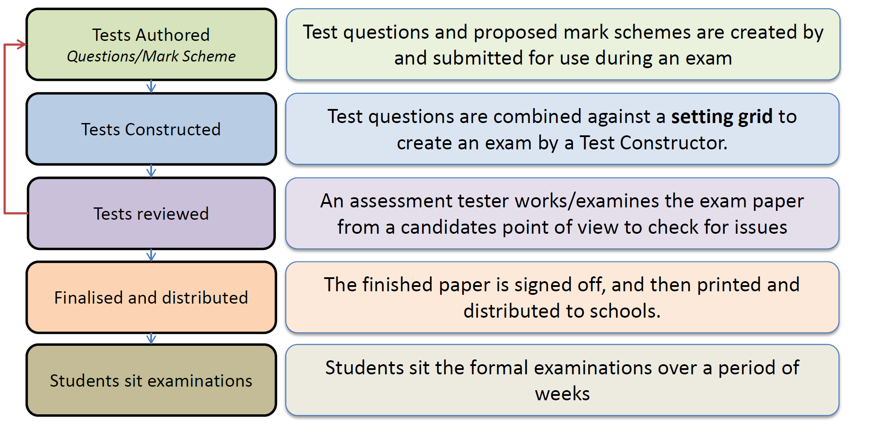
The Examination Process - OCR
Exam setting (simplified)

Slide 13
The Examination Process - OCR
Exam setting (simplified)
Content coverage over time is monitored
Assessment Standards Senior Manager signs off the final paper
Accessibility arrangements are considered, e.g. large fronts, colours within diagrams, language

Slide 14

How are exams created and marked?
Marking
https://www.youtube.com/watch?v=y4RZt2GZZT4
Other Awarding organisations have similar videos if you are not teaching OCR Specifications!
Compare the videos – the principles and processes across all organisations are very similar!

Slide 15
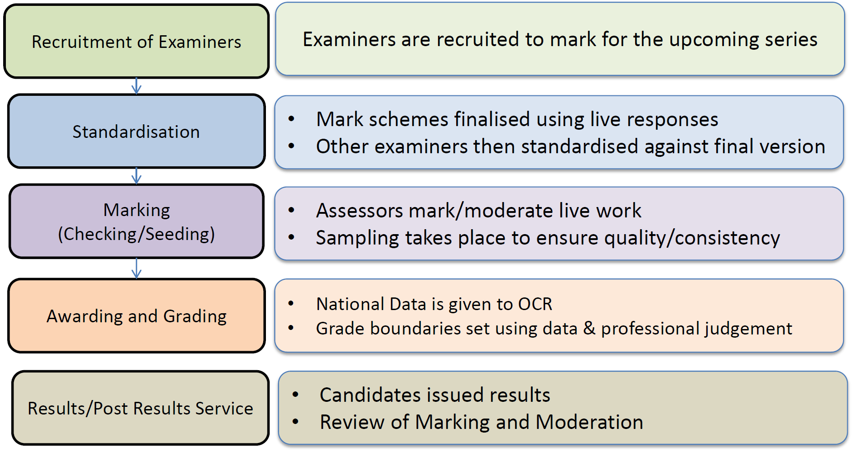
The Examination Process - OCR
Exam marking (simplified)

Slide 16
Some exam paper facts and statistics
It takes 12-18 months to produce an exam paper
We cannot use the exact same questions again
All content in specification must be covered over time
Spare papers are created in case of security breach
Costs £4,000 - £6,000 to create a paper
52 million scripts were marked by OCR (June 2017)
Candidate ages ranged from 8 to 72 years old (GCSE)
Cambridge Assessment employs over 13,000 assessors

Slide 17
Analysis of results
There are many ways to look at how an exam paper has performed:
  Reference to previous papers
    Are grade boundaries similar?
  Reference to national statistics
    Where do the grade boundaries lie?
  Item Level Data
    How well did each question perform?

Slide 18
Using item level data
Item level data gives us a much more precise analysis of performance
Use by awarding bodies | Use by schools
Test how ‘good’ a question was Indicator as to level of demand Allows comparison of question performance to paper performance Allows paper comparison in preparation Indicates accessibility of a paper | Active Results Comparisons between cohorts Identify strengths/weaknesses of previous teaching May aid performance management Identify challenging questions for use in teaching

Slide 19
Part 2
Key principles of assessment

Slide 20
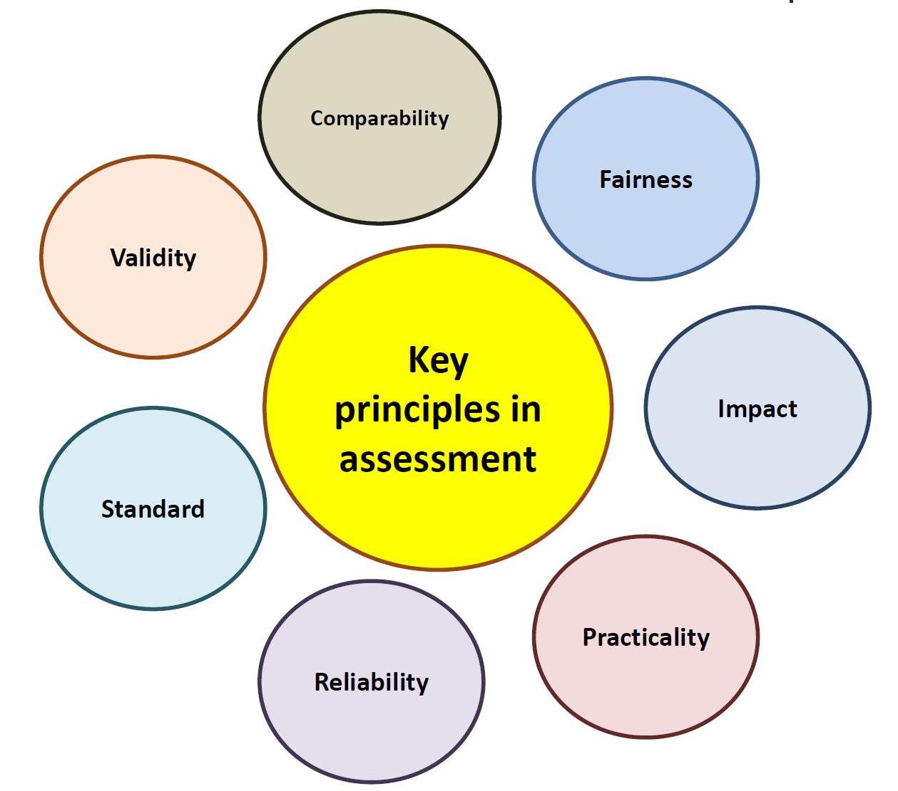
Key principles of assessment
Notes:
These are some of the key principles in assessment – a brief explanation of each follows.

Slide 21
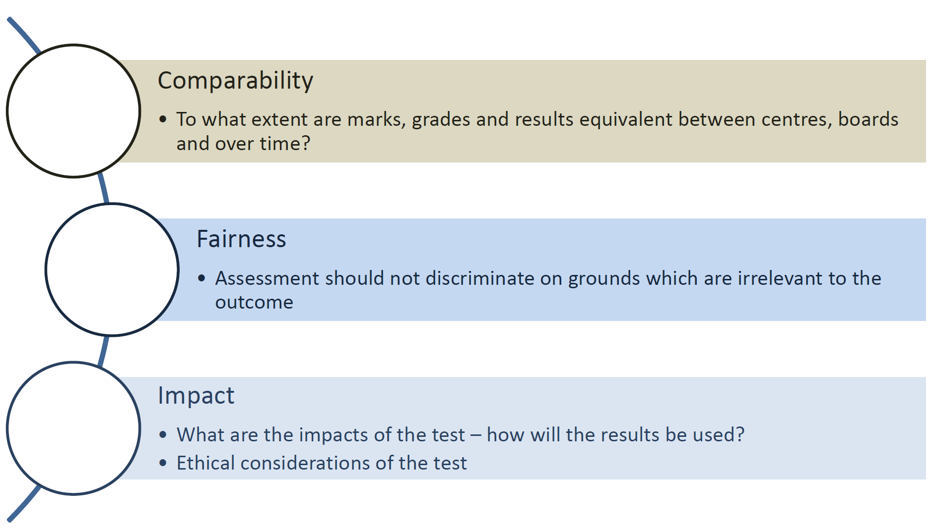
Key principles of assessment
Content

Slide 22
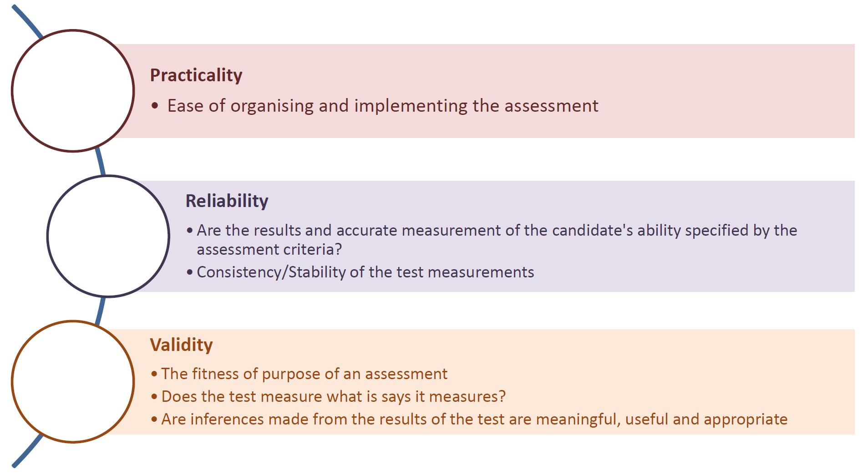
Key principles of assessment
Content

Slide 23
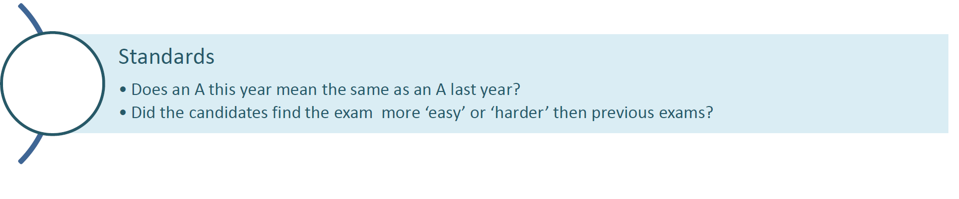
Key principles of Assessment

Slide 24
Validity ‘categories’
Does it look right? (Face)
Does it cover the specification? (Content)
Does it test the expected abilities? (Construct)
Will it reflect a candidate’s abilities? (Consequential)
Will it be an accurate predictor? (Predictive)
Do the results match outcomes from similar tests? (Concurrent)
Validity theory is an area of ongoing and developing debate. For instance – should ethics be involved in deciding if a test is valid or not?
Notes:
Validity is about whether an assessment measures what it is meant to measure, it goes to the heart of what a subject is.
Construct Validity is concerned with to what extent an assessment tests the construct of a qualification – for GCSE and A Level this would be the subject aims and learning outcomes set out in the subject content.

Slide 25
Reliability
Which of these is more/less likely to give reliable results?
Discuss
Computer marked multiple choice test
Examiners marking tests at a centralised venue
Examiners working with a bonus system for working faster
Essay questions
Structured questions
Specialist examiners applying professional judgement
Non specialists marking strictly to a defined mark scheme
Notes:
A computer marked multiple choice test would give the most reliable results – but might not be the most valid assessment.
Reliability can be more challenging in essay based subjective disciplines such as English and Religious Studies.

Slide 26
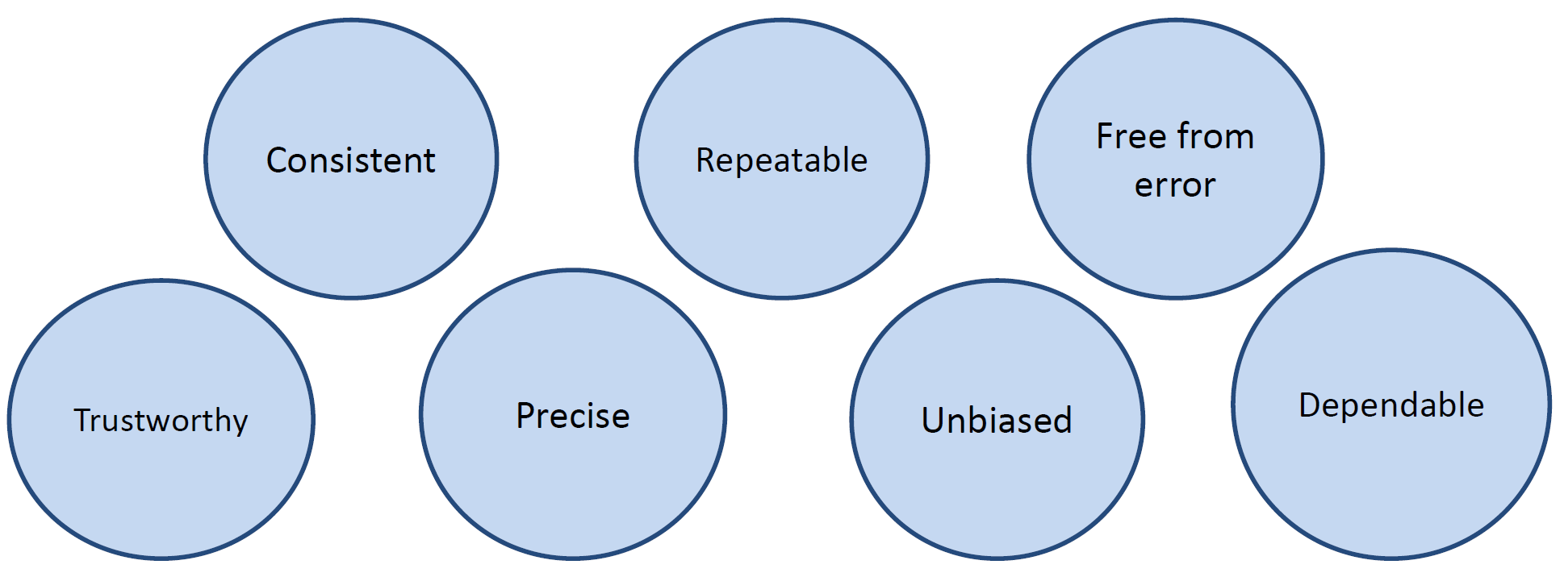
What does reliability mean in assessment?
Ofqual: “Reliability in educational measurement terms, refers to the consistency of results on a given measure from repeated measurements under equivalent conditions and is an important indicator of the quality of an assessment.”
Notes:
Reliability relates to the accuracy of marking – whether a hypothetical student would get the same mark on repeated attempts of the same test and whether different markers would give the same response the same mark

Slide 27
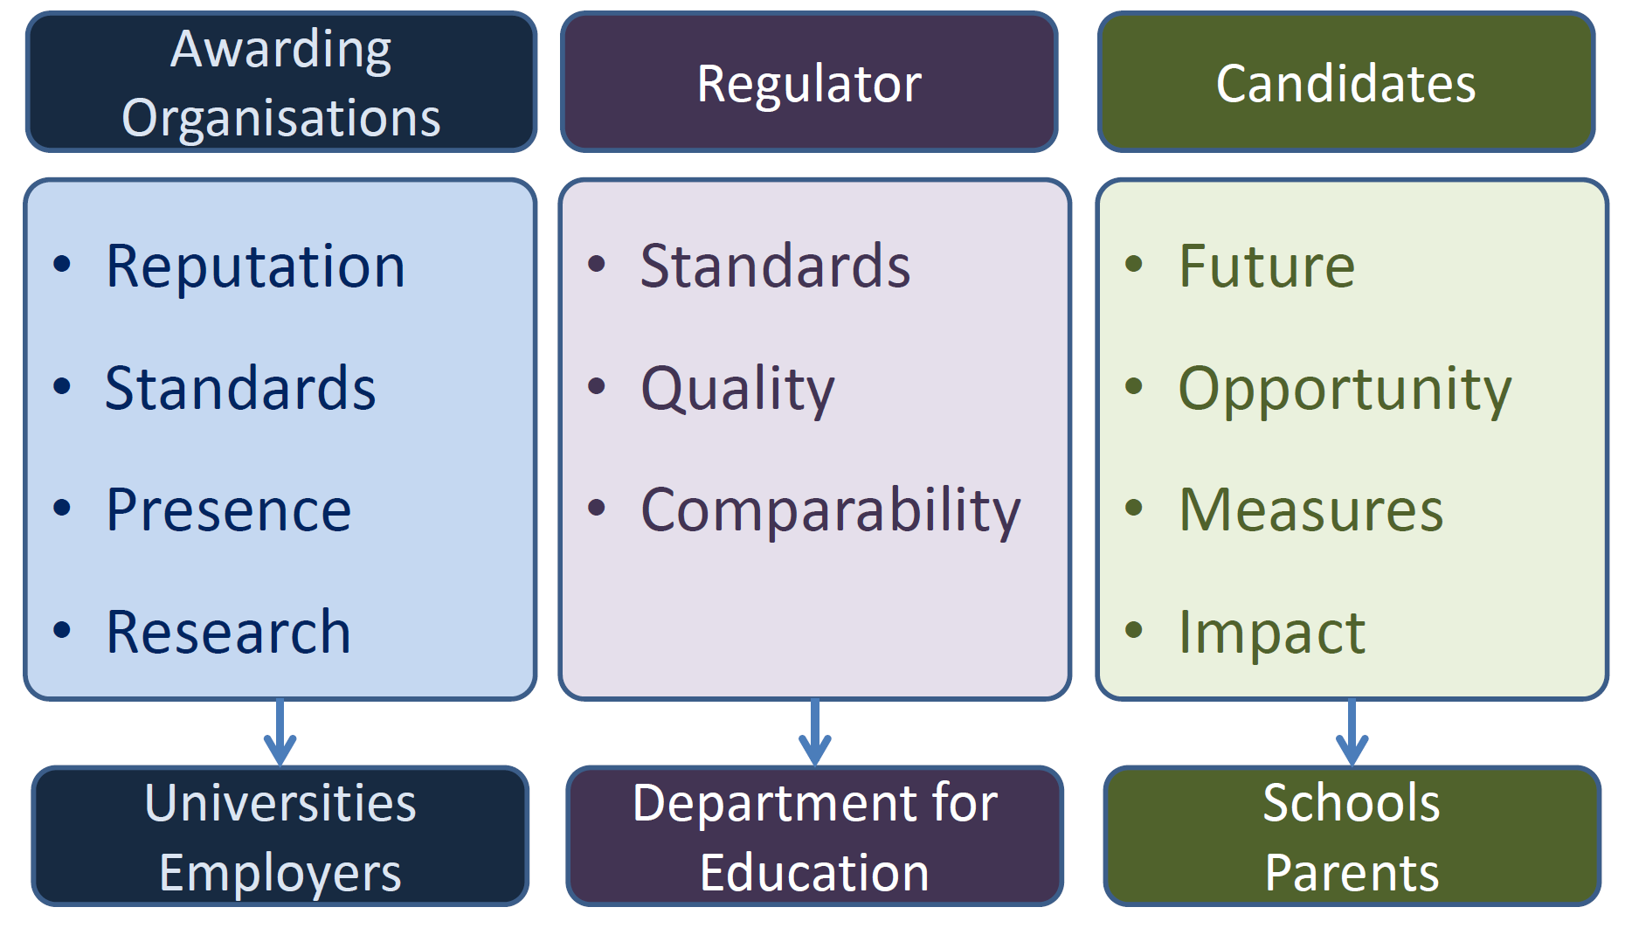
Stakeholders in assessment

Slide 28
Part 3
How we assess

Slide 29
Assessment objectives
What are Assessment Objectives?
  Outline what the students will be expected to demonstrate
  Cover all assessment content
  Give “sections” on which teaching can be scaffolded
  Form the basis of the exam paper questions
    Each question is likely to address an AO either solely, or as a structured question which covers more than one
  Can be in some cases linked to Bloom’s Taxonomy

Slide 30
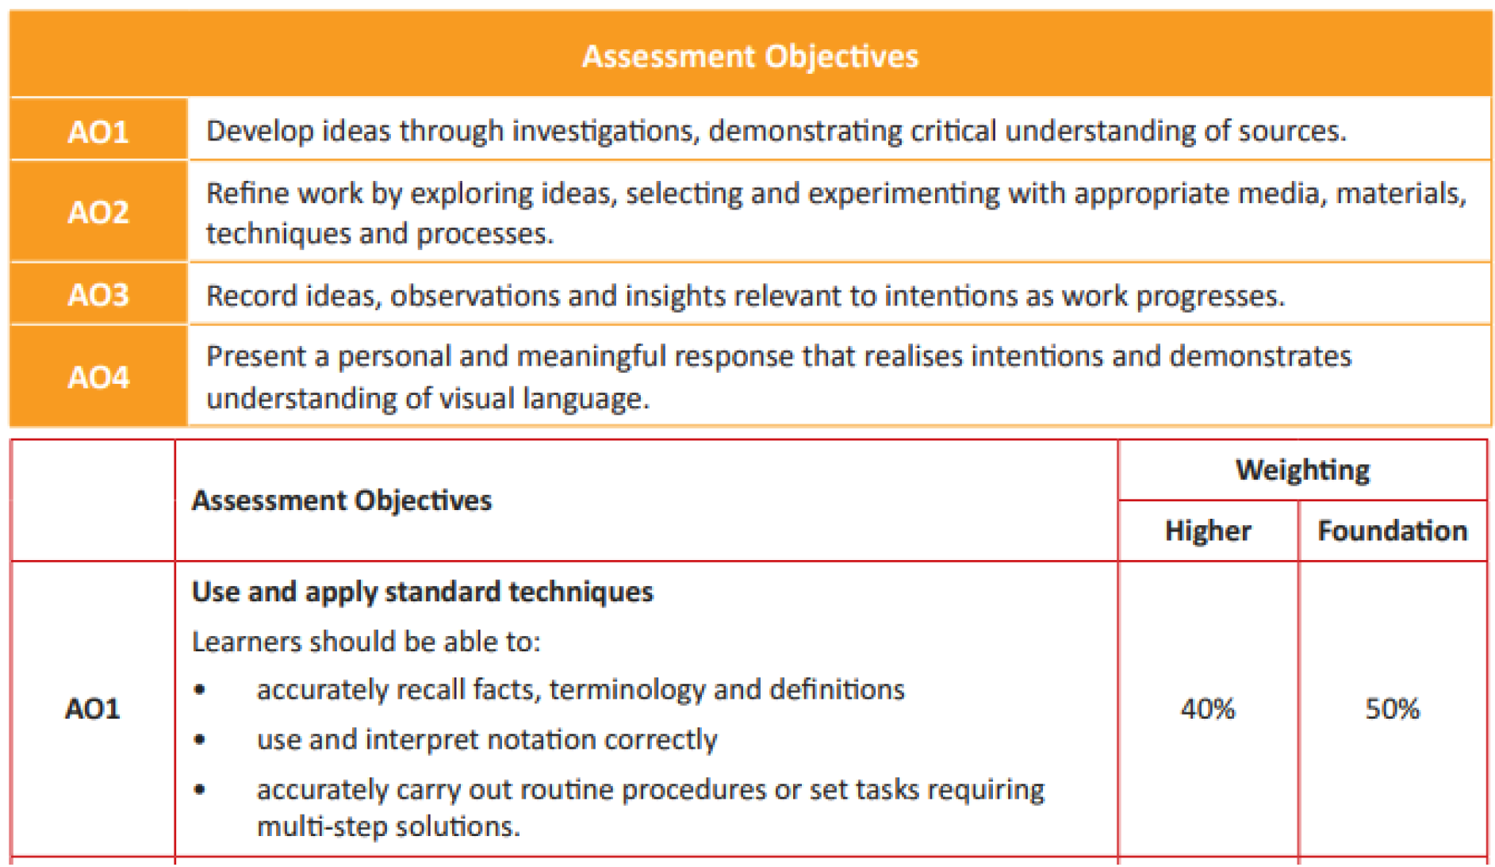
Assessment objectives examples

Slide 31
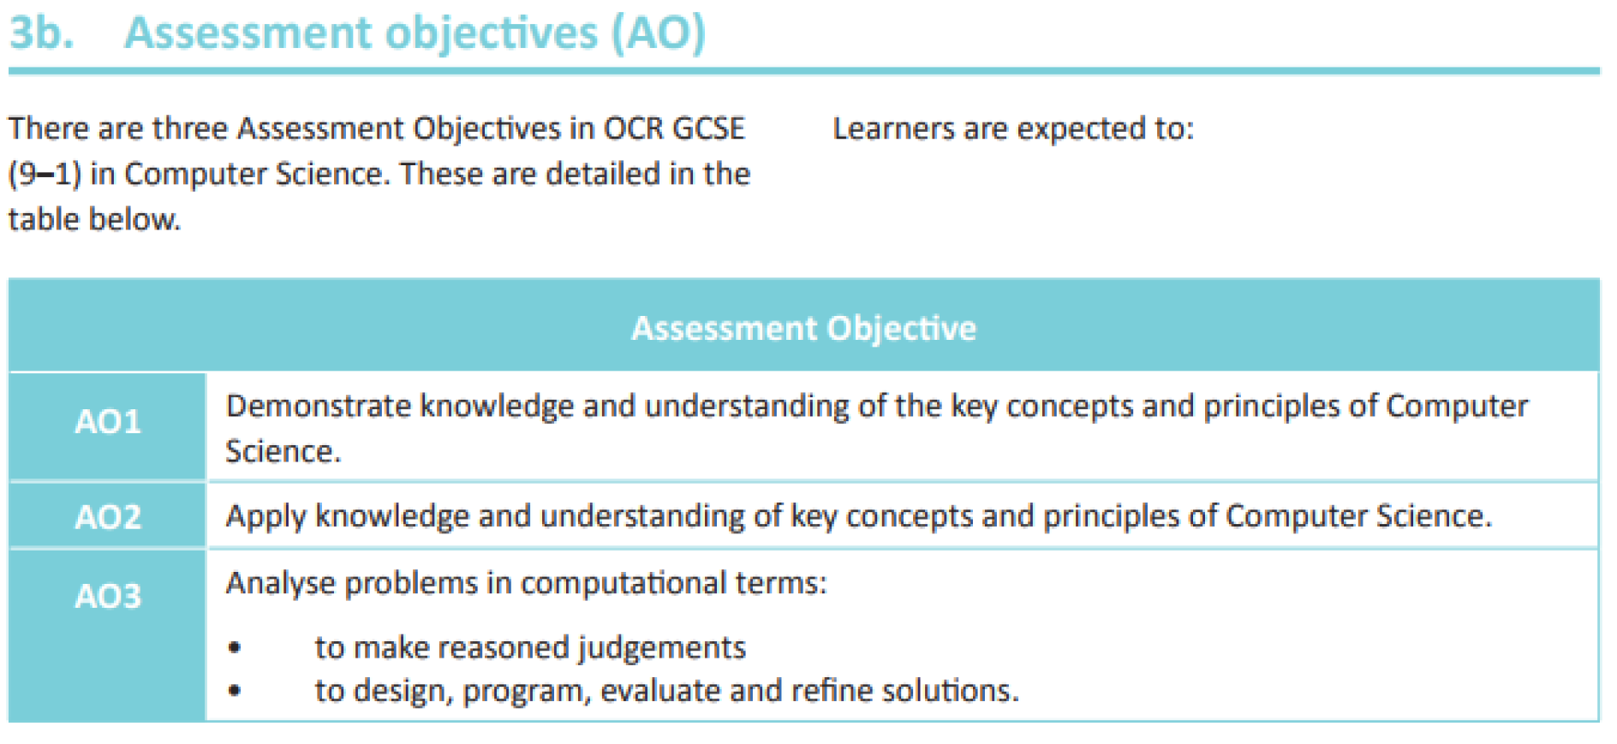
Assessment Objectives examples

Slide 32
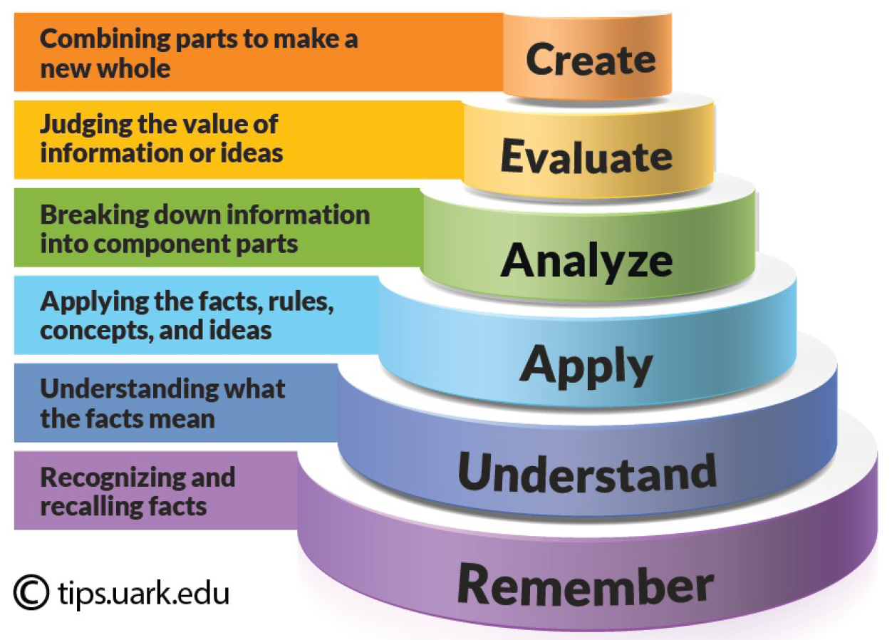
Assessment Objectives and Bloom?
A connection can be seen between AOs and Blooms Taxonomy
Notes:
Subjects vary – but AO1 normally assesses knowledge and understanding; AO2 assesses application and AO3 assesses evaluation.

Slide 33
Assessment Objectives
Assessment Objectives may blend the Bloom words
Some assessment objectives may mix skills and understanding
AOs are set by Ofqual
Awarding Organisations must show how they fulfil the weightings of AOs across their exam papers
The number of marks for each AO within an examination are consistent from year to year

Slide 34
Assessment Objectives in the Specification
Each assessment objective will have a weighting (%) for each paper
Each assessment objective may be covered in one or more of the papers
The percentage of each Assessment Objective is set by Ofqual (see here)
They also set what the Assessment Objective is…
Boards must meet the AO weightings and guidance set by Ofqual to be accredited
Much more interest is being shown is specifying what goes into specifications by the government
The detail in specifications is much more defined than before

Slide 35
Comparability of outcomes
“The extent to which marks, grades or results are equivalent between centres, between boards and over time.”
Each board’s grades should be comparable
What if they were not?
Comparability is regulated by Ofqual
There is a paper here that discusses comparability:
  Between centres
  Between boards
  Over time
Notes:
Comparable outcomes is the process whereby Ofqual and the exam boards seek to ensure that candidates are not be disadvantaged between boards or year to year.

Slide 36
Review – key terms in assessment
Comparability: The extent to which marks, grades or results are equivalent between centres, between boards and over time.
Fairness: Assessment should not discriminate on grounds that are irrelevant to the achievement of the outcome.
Impact: The effect created by a test, in terms of influence on general education processes, and of the individuals who are affected.
Practicality: The ease of organisation and arrangements associated with implementing the test.
Reliability:
  The extent to which assessment results are an accurate measurement of the candidates' demonstration of the abilities specified by the assessment criteria. (QCA)
  The consistency or stability of the measures from a test. The more reliable a test is, the less random error it contains.
Standard: The criteria for success at a particular level.
Validity:
  The fitness of purpose of an assessment tool or scheme. (QCA)
  The extent to which an assessment activity actually measures what it sets out to measure.
  The extent to which scores on a test enable inferences to be made which are appropriate, meaningful and useful, given the purpose of the test.

Slide 37
Plenary
What do you think are the best types of assessment for your subject? Why?
Think about types of question and qualification design including:
Multiple choice questions
Structured questions
Essay questions
Linear assessment
Modular assessment
Examinations
Non exam assessment

Slide 38
Slide title
Content

Slide 39
Slide title
Content
Content

Slide 40
Quote text

Slide 41
Content

Slide 42
Quote text

Slide 43
Quote text

